Slide 1
LOCATION MANAGEMENT

Slide 2
INTRODUCTION
What happens when a mobile user changes location?
Who should know about the change?
How can you contact a mobile host?
Should you search the whole network or does anyone know about the mobile users moves?

Slide 3
INTRODUCTION
The main task of LM is to keep track of a user’s location all the time while operating and on the move so that incoming messages (calls) can be routed to the intended recipient.

Slide 4
LM consists mainly of
Location Tracking and Updating (Registration)
Location Finding (Paging)

Slide 5
Location Tracking and Updating (Registration)
A process in which an end-point initiates a change in the Location Database according to its new location. This procedure allows the main system to keep track of a user’s location

Slide 6
Location Finding (Paging)
The process of which the network initiates a query for an endpoints location. This process is implemented by the system sending signal to all cells so that one of the cells could locate the user.
Difference between location tracking and paging is

Slide 7
Location Based Services
Services that integrate a mobile device’s location or position with other information so as to provide added value to a user.
OR
services that use the location of the target for adding value to the service, where the target is the entity to be located

Slide 8
Classification of LBSs
Reactive LBSs
Proactive LBSs

Slide 9
Reactive LBSs
Reactive LBSs are always explicitly activated by the user. the user first invokes the service and establishes a service session, either via a mobile device or a desktop PC. The user then requests for certain functions or information whereupon the service gathers location data

Slide 10
Proactive LBSs
Proactive LBSs are automatically initialized as soon as a predefined location event occurs, for example, if a user enters, approaches, or leaves a certain point of interest or if he/she approaches, meets, or leaves another target

Slide 11
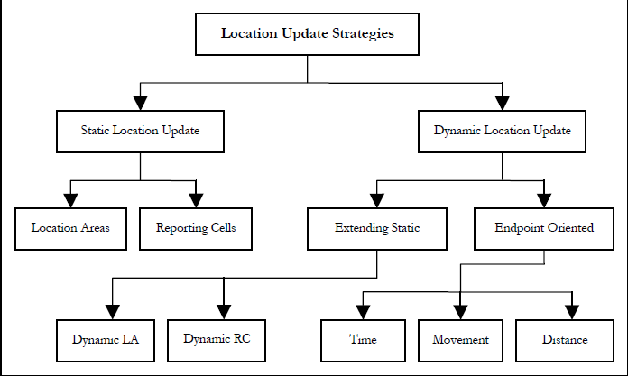
Location Tracking and Updating

Slide 12
Static Update Strategies
In this approach, there are specific areas in which an update could take place.
If a mobile host enters any one of these areas, an update takes place
Two approaches of static updating are
Location Areas (LAs)
Reporting Cells

Slide 13
Location Areas (LAs)
Also referred to as Paging Areas or Registration Areas
service areas are created with each area considered a LA
Only when a mobile host moves from one LA to another that an update to its location in the Location Database is taken place.

Slide 14
Reporting Cells
updates take place at specific centers (cells) in the network. Only when a mobile host gets re-located to one of these centers that an update takes place.

Slide 15
Dynamic Update Strategies
In this strategy, a mobile host determines when an update should take place based on its movement, frequency of incoming messages, signal strength and other factors.
A) Threshold-Based
B) Profile Based

Slide 16
Threshold-Based
In threshold-based schemes each mobile device maintains a particular parameter, updating its location when the parameter increases beyond a certain threshold.
LIKE
Time-based location updates that take place every T seconds.
Movement-based location updates that take place after every M cell crossings.
Distance-based location updates that take place whenever the distance covered exceeds D

Slide 17
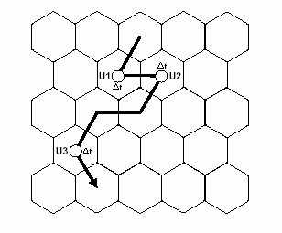
Time-Based Update:

Slide 18
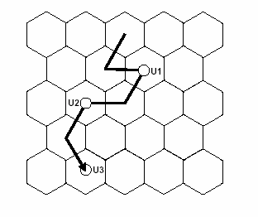
Movement-Based Update:

Slide 19
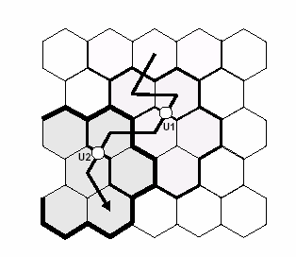
Distance-Based Update

Slide 20
Profile-Based
Under a profile-based scheme the network maintains a profile for each user in the network, based on previous movements, containing a list of the most probable cells for the user to reside within. On a location update the network sends this list to the mobile device, forming what may be considered a complex location area. The mobile device updates its location only when entering a cell not contained in the list

Slide 21
Location Finding (Paging)
the network needs to be able to precisely determine the current cell location of a user to be able to route an incoming call. This requires the network to send a paging query to all cells where the mobile device may be located, to inform it of the incoming transmission.

Slide 22
Simultaneous Paging
The simultaneous paging scheme, also known as blanket paging, is the mechanism used in current GSM network implementations. Here all cells in the users’ location area are paged simultaneously, to determine the location of the mobile device. This requires no additional knowledge of user location but may generate excessive amounts of paging traffic

Slide 23
Sequential Paging
Sequential paging avoids paging every cell within a location area by segmenting it into a number of paging areas, to be polled one-by-one. It is found in that the optimal paging mechanism, in terms of network utilization, is a sequential poll of every cell in the location area individually,

Slide 24
Intelligent Paging
The intelligent paging scheme is a variation of sequential paging, where the paging order is calculated probabilistically based on pre-established probability metrics . Intelligent paging aims to poll the correct paging area on the first pass, with a high probability of success.

